Slide 1
The role of geologists under the enforcement of the Geology Act in Taiwan
Taiwan Association of Professional Applied Geologists
I-Chin Yen
2017/11/17
Hong Kong

Slide 2
Geology Act (地質法)
Announced Date:
December 8, 2010
22 Articles
Chapter I General Principles
Chapter II Geological Survey System
Chapter IV Penal Provisions
Chapter V Supplementary Provisions
Chapter III Geological Data Management and Geological Research
總則
附則
地質調查制度
地質資料管理
及地質研究
罰則

Slide 3
Chapter II Geological Survey System
Article 4
National basic geological survey
National geological resources survey
National geological hazards survey
establish a national geological database
全國基本地質調查
comprehensively reviewed at least once every 5 years
每五年應通盤檢討一次
全國地質災害調查
全國資源地質調查
Other geological surveys approved by the central competent authority
其他經中央主管機關認定之地質調查
建立全國地質資料

Slide 4
Chapter II Geological Survey System
Article 5
The central competent authority (CENTRAL GEOLOGICAL SURVEY, MOEA )shall publicly announce areas to be geologically sensitive areas.
Geologically sensitive areas
special geologic scenery
special geological environments
potential geological hazards
中央主管機關(經濟部中央地質調查所)應將具有特殊地質景觀、地質環境或有發生地質災害之虞之地區，公告為地質敏感區。
特殊地質景觀
特殊地質環境
地質敏感區
有發生地質
災害之虞

Slide 5
Chapter II Geological Survey System
Article 8
Should a site of land development activity fall in whole or in part within a geologically sensitive area, it shall first undergo a geological site investigation and geological safety assessment before an application for land development is filed.
土地開發行為基地有全部或一部位於地質敏感區內者，應於申請土地開發前，進行基地地質調查及地質安全評估。

Slide 6
Chapter II Geological Survey System
Article 10
Professional Engineers
Geological Site investigations and geological safety assessments
Professional applied geological engineers
Professional geotechnical engineers
Professional mining engineers
Professional civil engineers
Professional soil and water conservation engineers
Professional hydraulic engineers
可執行「地質法」
基地地質調查與地質安全評估的專業技師
應用地質技師
大地工程技師
土木工程技師
礦業技師
水利工程技師
水土保持技師

Slide 7
Geologically Sensitive Areas Types
Groundwater recharge
Geologically Sensitive Areas
Active fault
Geologically Sensitive Areas
Geoheritage
Geologically Sensitive Areas
Landslide
Geologically Sensitive Areas
地質遺跡
地質敏感區
山崩與地滑
地質敏感區
地下水補注地質敏感區
活動斷層
地質敏感區

Slide 8
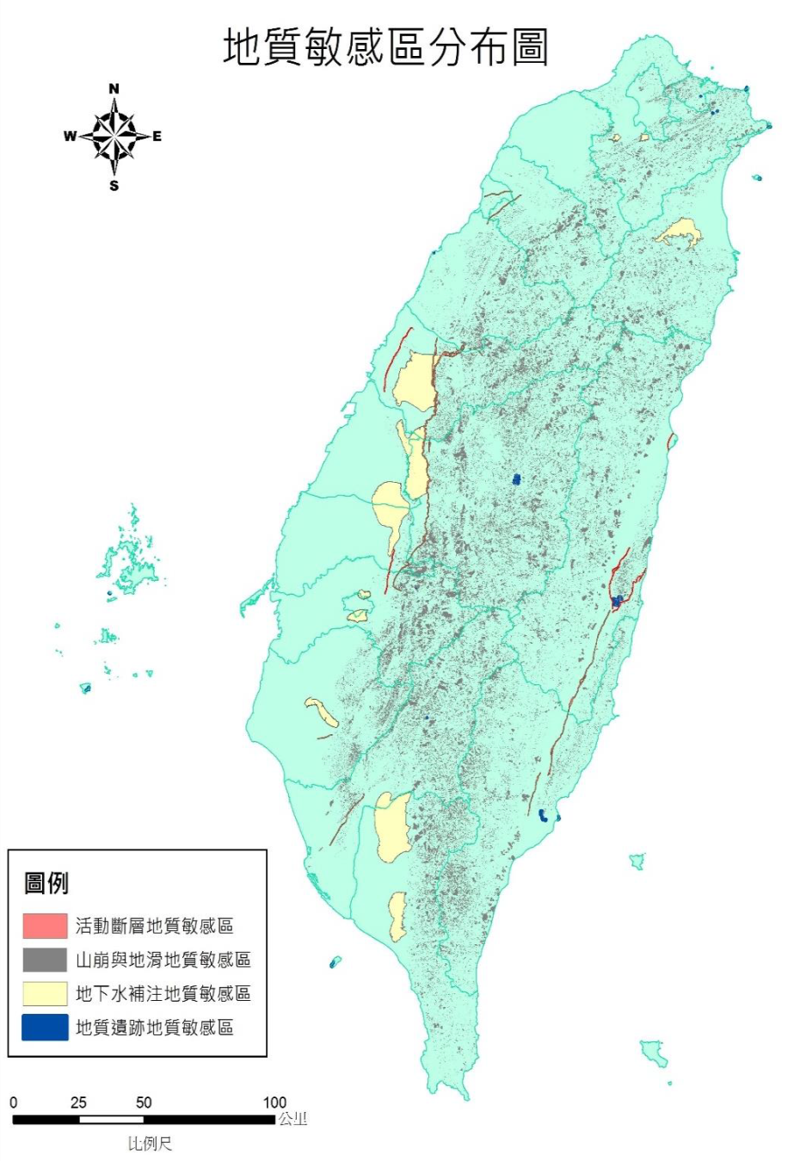
Geologically Sensitive Areas in Taiwan
地質遺跡： 共約8.18平方公里，約國土面積0.02%。
地下水補注：共約1162.7平方公里，約國土面積3.21%。
活動斷層： 共約126平方公里，約國土面積0.35%。
山崩與地滑：共約3990.62平方公里，約國土面積11.03%。
合計約5287.5平方公里，約國土面積14.6%。
(本資料參考自2017年地質敏感區與土地開發研討會)

Slide 9
What a professional applied geologist can do?
Professional Applied Geologist
Promoting geological education and raising the public’s consciousness of the geological environment
Report reviews
Geological Site investigations and geological safety assessments
Geological hazard appraisals
基地地質調查與地質安全評估報告審查
基地地質調查與地質安全評估
地質教育推廣
地質災害鑑定

Slide 10
Qualification of professional applied geological engineer
Passed the Professional and Technical Senior Examinations
Possessed the professional applied geological engineer certificate under Professional Engineer Act
Having gained at least two years of applied geological engineering experience
Obtaining the professional applied geological engineer license from the central competent authority
通過專門技術人員國家考試
取得應用地質技師證書
兩年以上地質相關工作經驗
取得合格應用地質技師執業執照
You are Professional Applied Geologists
Joint Association of Professional Applied Geologists
加入應用地質技師公會

Slide 11
Information
技師法(http://law.moj.gov.tw/Law/LawSearchResult.aspx?p=A&t=A1A2E1F1&k1=%E6%8A%80%E5%B8%AB%E6%B3%95)
地質法 (http://law.moj.gov.tw/LawClass/LawAll.aspx?PCode=J0020052)
考選部「專門職業及技術人員考試」 (http://wwwc.moex.gov.tw/main/home/wfrmHome.aspx?menu_id=3)
經濟部中央地質調查所「地質法專區」 (http://www.moeacgs.gov.tw/newlaw/newlaw.htm)
臺灣省應用地質技師公會 (https://sites.google.com/site/geo54088/ ; https://www.facebook.com/168geo/)

